Slide 1
2026 DRAFT
COMPREHENSIVE STORMWATER MANAGEMENT PLAN
For the Village of Trumansburg, New York
Tompkins County
October 26, 2026

Slide 2
Project Development and Work Completed to Date
2016 the Village and MRB collaborated on improvements to the Culvert crossing on Lake Street
    The Project was advertised for Public Bid with Low Bidder ($49,950.00) and improvements constructed.
    Isolated and defined project area that received considerable volume of flow through R.O.W. Drainage ditch and an outlet to Trumansburg Creek
2017 the Village hired MRB Group to perform a Preliminary Drainage Investigation of the Village
      MRB walked the Village documenting existing infrastructure and understanding topography of the Village
2020 the Village submitted a State and Municipal(SAM) Grant application and received an award in July 2020 for $125,000
      MRB developed design documents for three (3) project areas: East Seneca Road, Congress Street and Seneca Street. Based on bids received and grant total, East Seneca Road Project was awarded for $87,000.00
      In later years, the Village was able to assist with performing construction improvements along Congress Street with the remaining Grant Dollars
2022 the Village hired MRB Group to perform a Drainage Area Investigation near Larchmont Drive
2023 the Village hired MRB Group to develop a Comprehensive Stormwater Management Plan
      A Comprehensive Stormwater Management Plan was discussed as the next logical step given the ongoing feedback of drainage needs in various isolated locations of the village
October 26, 2026

Slide 3
Comprehensive Stormwater Management Plan PROJECT APPROACH
Building on the 2017- 2019 Drainage Investigation efforts, MRB surveyed existing infrastructure and developed a Geographical Information System (GIS)
Define and evaluate various sub-drainage areas in the Village
Calculate and assign flows for each sub-drainage area
Engage Public for feedback:
  Pictures from residents submitted to Village/MRB Group
  Noted areas with deficiencies or localized flooding based on feedback from residents conveyed to Village and MRB Group
  Input from DPW and Village Trustees
Build off Village input and evaluate project areas. Goal to develop project(s) to improve drainage in isolated or broader areas and develop associated cost estimates
Work to develop a priority ranking system for various project(s) and identify how projects can be implemented for construction
Understand available Grant Programs and project type. How do we implement or consturct?
    Can Village DPW take on project?
Develop a Stormwater Ordinance and adopt the Law
Develop Specifications and Details for any new stormwater infrastructure improvements implemented in the Village (new developments, replacement of infrastructure, etc.)
October 26, 2026

Slide 4
Comprehensive Stormwater Management Plan PROJECT CONSTRAINTS
To help develop a Comprehensive Stormwater Management Plan – MRB Group and the Village spread the project scope out over three (3) budget cycles to limit the financial impact on any one budget cycle.
The Village is limited to making improvements to infrastructure solely within the village Right-of-Way boundary.
  NYS Route 96 Main Street is a NYS Department of Transportation Right of Way (66’ from edge of ROW to edge of ROW). DOT maintains stormwater infrastructure along NYS Route 96.
  Village Right of Ways may vary (typ. 49.5’ from edge of ROW to edge of ROW). Beyond the highway R.O.W. is responsibility of the property owner.
Evaluate which improvements within Village Right-of-Way may provide lasting benefit to the village
Evaluate where Green Infrastructure Improvements can be implemented.
  With a built-out Village such as Trumansburg, available and useable land for retention or detention ponds is limited. Specifically, when considering available lands and proximity to village ROW.
  Implementing stormwater storage ponds can reduce the flowrates being discharged.
Historically, stormwater infrastructure has been underfunded and there have been few state/federal programs that have supported Stormwater Infrastructure Improvements.
Age of the Village Infrastructure likely dates to the 1960’s or earlier.
Infrastructure was not designed for the intensity and duration of storms being experienced. To design improvements to the 50-year, 100-year or 500-year event would be impractical and cost prohibitive. This puts design engineers and municipalities in a conundrum.
Village is bordered by Town of Covert (Seneca County) and the Town of Ulysses (Tompkins County), these boundaries drive intermunicipal cooperation and coordination for Village projects
Upstream or Downstream impacts
October 26, 2026

Slide 5
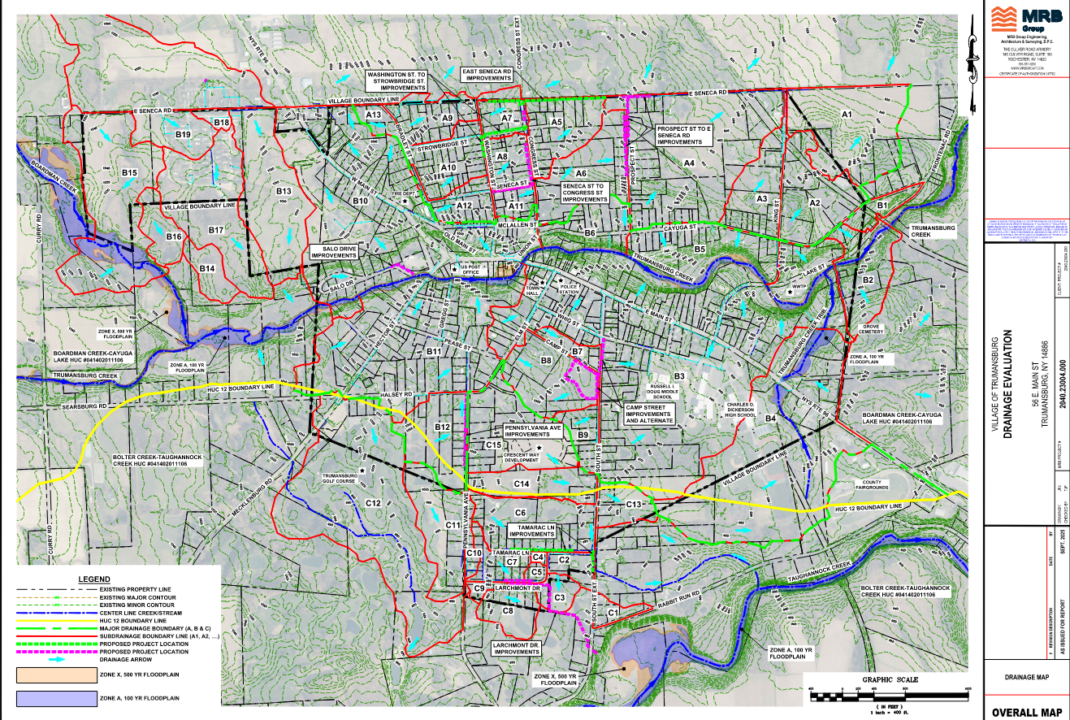

Slide 6
Comprehensive Stormwater Management Plan Project Locations and Costs
A total of nine (9) project areas were identified, evaluated and proposed improvements outlined with a Cost Estimate.
In total, $3,640,000 in 2026 dollars were estimated. This is not a ‘complete’ needs assessment of the Village, but a total estimate based on the nine (9) project areas
Ranking System
  Flood Severity = considered areas with largest total flows and impacts to existing infrastructure.
  Property Impact = considered the number of properties impacted in the project area.
  Green Infrastructure Impact = projects incorporating green infrastructure were awarded higher point totals
  Stormwater Infrastructure = initial condition assessment of existing infrastructure and potential to improve other areas (i.e. reduce a bottleneck)
Project Areas:
Priority | Project/Location | Flood Severity | Property Impact | Green Impact | Stormwater Infrastructure | Total | Estimated Project Cost
1 | East Seneca Road | 25 | 20 | 20 | 25 | 90 | $289,000
2 | Camp Street | 15 | 20 | 25 | 15 | 75 | $1,179,000
3 | Tamarac Lane | 20 | 20 | 10 | 20 | 70 | $296,000
4 | Pennsylvania St. | 15 | 20 | 20 | 15 | 70 | $188,000
5 | Larchmont Drive | 15 | 20 | 10 | 20 | 65 | $529,000
6 | Washington St to Strowbridge St. | 20 | 15 | 0 | 15 | 50 | $385,000
7 | Seneca St to Congress St. | 15 | 10 | 0 | 20 | 45 | $223,000
8 | Prospect St. to E. Seneca Rd. | 10 | 15 | 0 | 15 | 40 | $461,000
9 | Salo Drive | 10 | 10 | 10 | 5 | 35 | $90,000
* Each category is out of 25 points |  |  |  |  |  | Total = | $3,640,000
October 26, 2026

Slide 7
Comprehensive Stormwater Management Plan Next Steps and Moving Forward
  Gain public feedback, review the DRAFT Stormwater Ordinance with Village Trustees and engage Village Attorney prior to adopting the ordinance.
  Focus on areas or projects where DPW can tackle smaller isolated projects and self-administer projects ‘in house’.
  Submit for Grant Funding for larger projects to offset financial impacts to the village. Larger scale or more involved projects may look at Green Infrastructure Improvements. Typically, will be publicly bid project
  Review/update priorities on an annual basis, things change and the environment is dynamic.
  Follow along at https://trumansburg-ny.gov/. There is a stormwater manage link and sign up form for the Village's weekly email at the bottom of page.
October 26, 2026

Slide 8
Questions?
Matthew McKenna, EIT
Project Manager III
October 26, 2026

